Slide 1
Clinical Information Services & Your Librarian

Slide 2
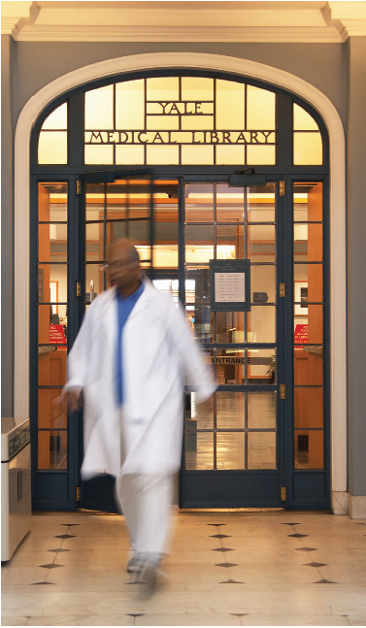
Welcome to Yale
The Cushing/Whitney Medical Library is here to support you!
library.medicine.yale.edu/services/clinical

Slide 3
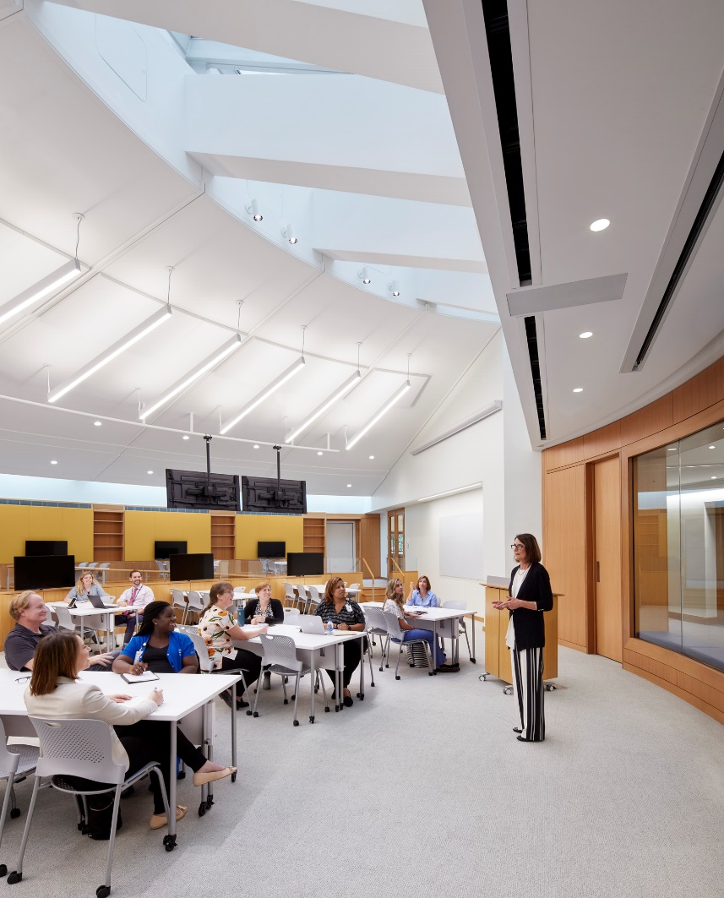
Personalized Help
Training and assistance with topics like:
Searching the literature
Citation management
Didactic sessions
Systematic reviews & evidence synthesis
Presenting at Grand Rounds
Journal clubs
Library orientations & tours
Teaching

Slide 4
Collections
Access to:
Top medical databases like PubMed, ClinicalKey, and UpToDate.
Thousands of medical e-journals and e-books
A suite of medical-related mobile apps

Slide 5
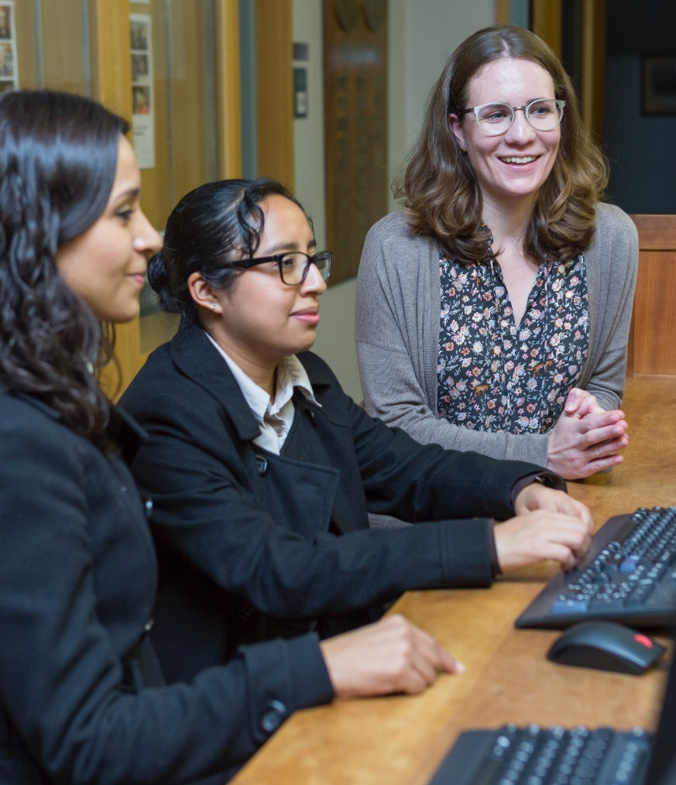
Training & Guides
Resource guides for your specialty
Classes & video tutorials

Slide 6
Research Services
Support for:
Bioinformatics
Statistics & GIS
Research Data
Scholarly Communications & Research Impact

Slide 7
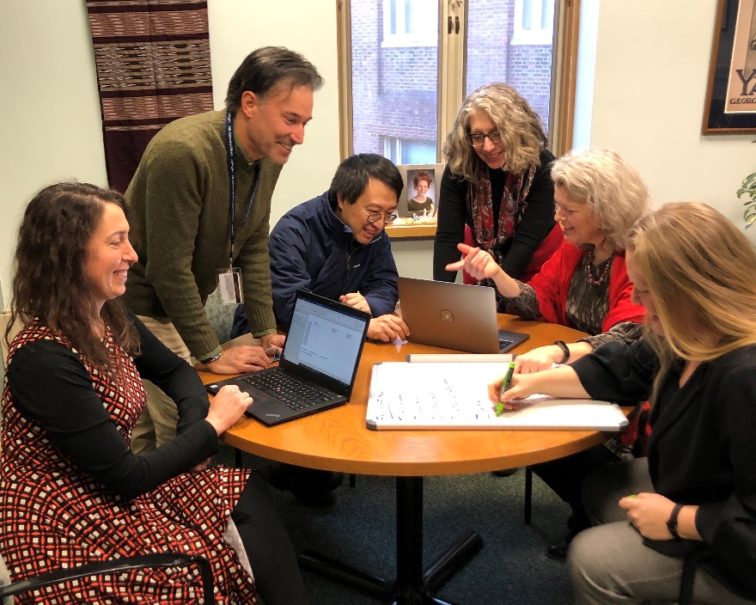
Systematic Review Service
Librarians as consultants or co-authors on systematic review teams:
Select appropriate databases for search topic
Devise search strategies
Obtain PDFs for screening
Write the literature search methodology section

Slide 8
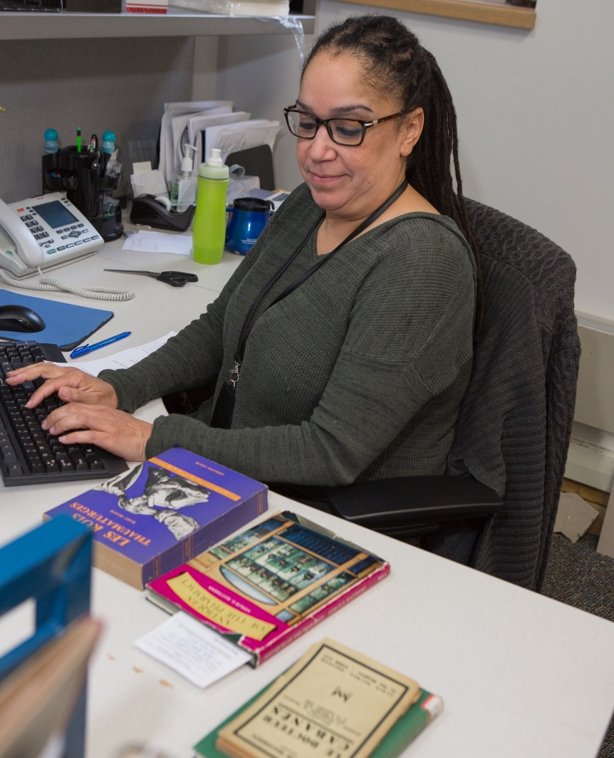
Resources You Need On & off campus
Interlibrary Loan for items we don’t own
Off-Campus Access to library resources from outside the Medical Center

Slide 9
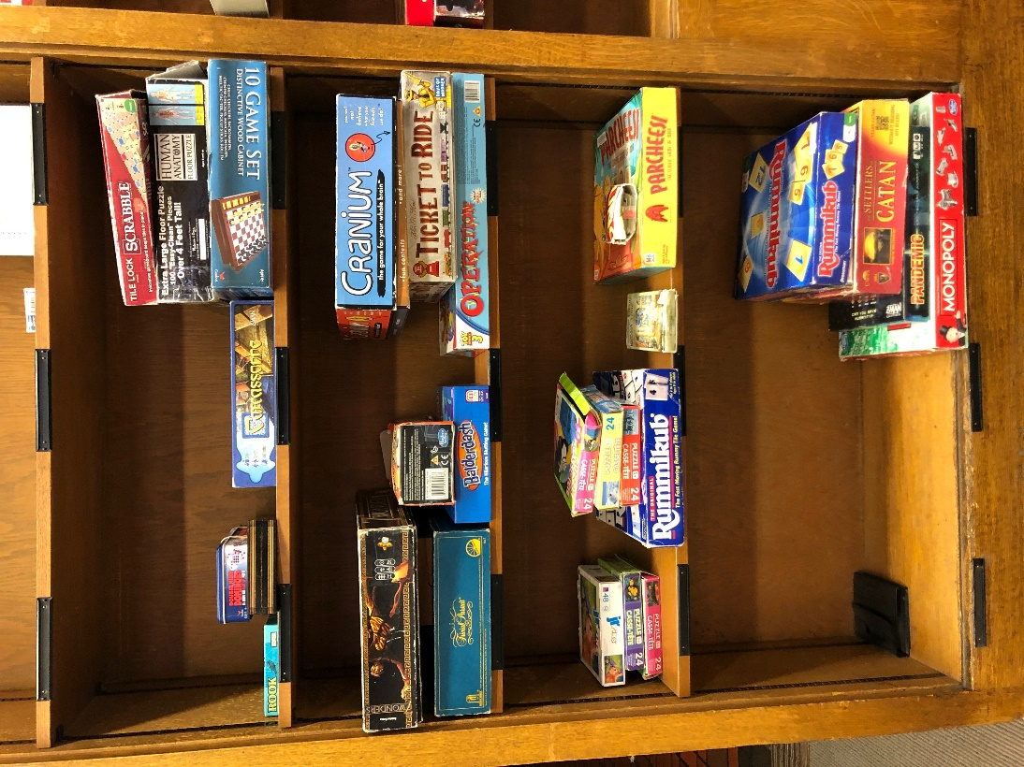
More than Books!
Games and puzzles
Phone chargers
Laptops and chargers
Cameras and video equipment
Projectors
library.medicine.yale.edu/services/library-technology

Slide 10
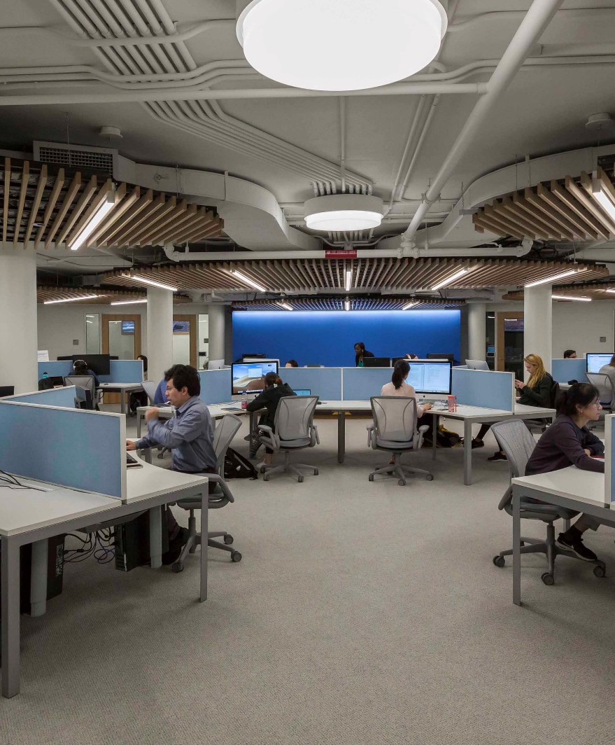
Tools to Succeed
ITS Software Library
ArcGIS, EndNote, and more!
Free cloud storage with Yale Box
IT Help Desk in medical library lower level
its.yale.edu

Slide 11
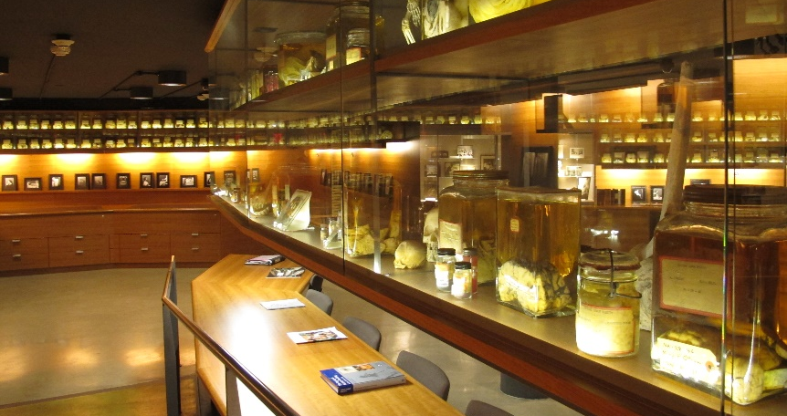
Special Collections
The Cushing Center: over 300 brain and tumor specimens, microscopic slides, and thousands of photographic negatives.
The Historical Library: collections of rare medical books, medical journals, pamphlets, prints, and photographs, as well as current works on the history of medicine.

Slide 12
Yale University Libraries
Within the YUL system, you’ll find resources for:
Business
GIS
Divinity
Arts & humanities
Science & social sciences
Leisure reading
Law
library.yale.edu

Slide 13
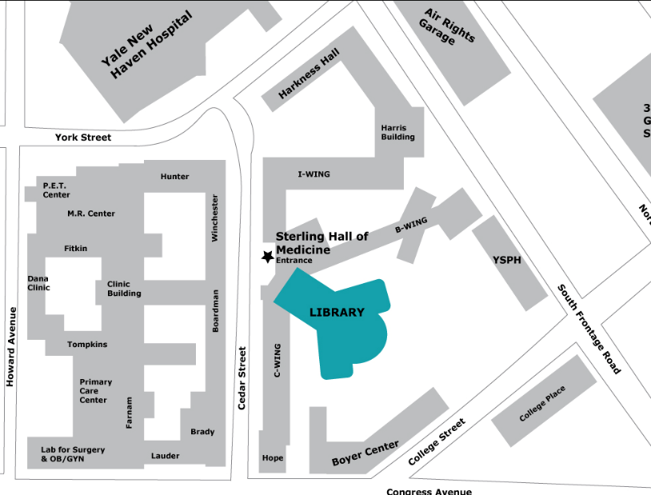
Where are we located?
Cushing/Whitney Medical Library
Sterling Hall of Medicine, L-Wing
333 Cedar Street
New Haven, CT 06510
Clinicians’ Study Center
St. Raphael’s Campus
Orchard Medical Building (Room E113)
Visit our website for more information

Slide 14
Contact Us!
Clinical.librarians@yale.edu
Or find your research & education librarian
library.medicine.yale.edu/research-help/liaisons

